Slide 1





PROJECT NAME
Team : Name & Email id Guide:
Disclaimer: The content is curated for educational purposes only.
Notes:
Slides: Prepare a short slide deck (10-12 slides) summarizing the project objectives, methodology, and key results.

Slide 2
OUTLINE
Abstract of the Project
Problem Statement
Proposed Solution
System Architecture
Live Demo of the Project
Embedded Video of Project
Conclusion
Future Scope

Slide 3
Abstract

Slide 4
Problem Statement

Slide 5
Proposed Solution

Slide 6
System Architecture

Slide 7
Live Demo of Project

Slide 8
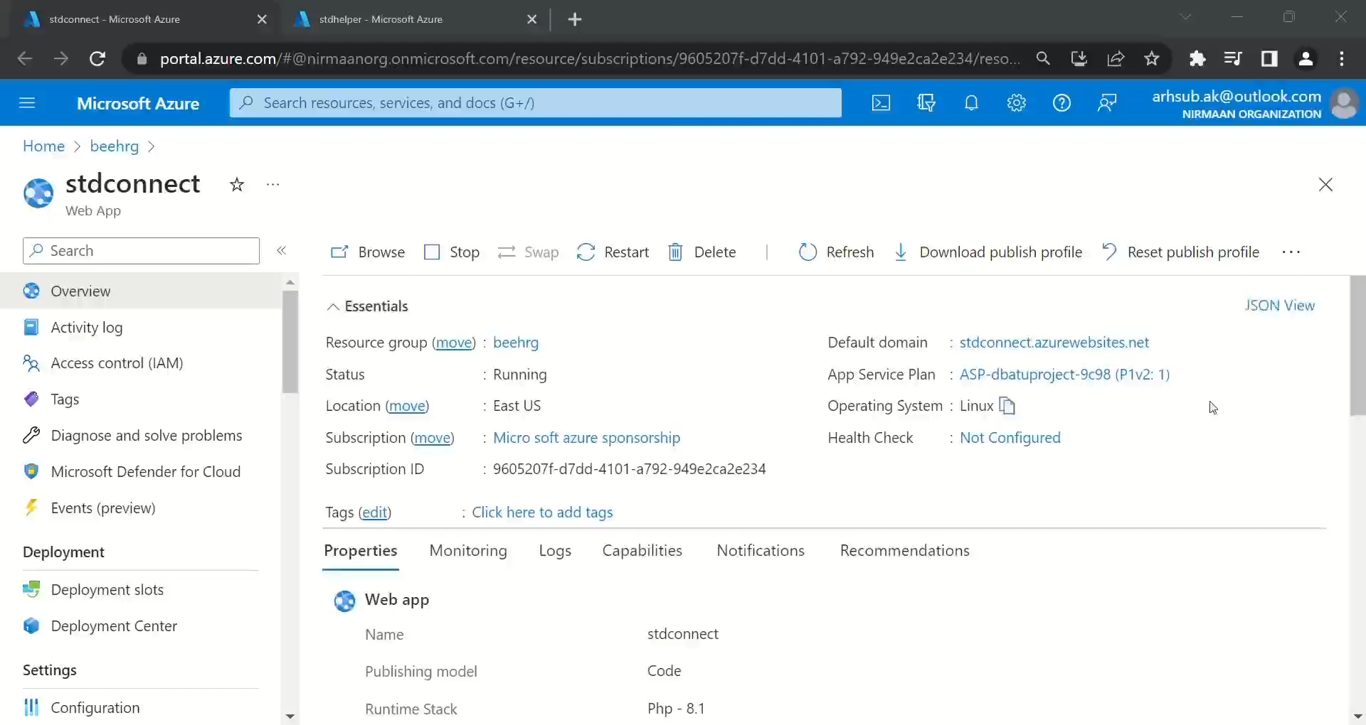
Video of Project Demo

Slide 9
Conclusion

Slide 10
Future Scope

Slide 11
Thank you!
Notes:
thank you very much for joining this PPT, keep learning.
11

